Slide 1

Mini Project (KCA451) Odd Semester Session 24-2025
Job Portal App
Name:- Rishabh Kumar Tripathi
Roll no. :- 2300290140139
Project Supervisor:
Dr. Neha Tyagi
Associate Professor

Slide 2
Content
Introduction
Literature Review
Objective of the Project
Technology
Hardware Requirements
Software Requirements
Modules Workflow Reports
Er – Diagram
Reports
References
Notes:
Font Styles: Times New Roman + Font Size: 25

Slide 3
Introduction
Title: Building a Feature-Rich MERN Stack Job Portal
Overview:
This project aims to create a job portal application using the MERN stack (MongoDB, Express.js, React, Node.js), which allows users to register, create profiles, search and apply for jobs, and for companies to post job openings.
The portal includes advanced features such as:
Automated newsletters for notifying users of new job opportunities.
Profile management for both users and companies.
Job postings and tracking with user-friendly interaction.
Secure authentication using modern security practices like JWT (JSON Web Tokens).
Notes:
Font Styles: Times New Roman + Font Size: 25

Slide 4
Literature Review
Modern Web Application Practices:
Automated tasks with Node Cron.
Secure Authentication: JWT, OAuth2.
Redux for state management: Efficient handling of user data, job postings, and applications.
Notes:
Font Styles: Times New Roman + Font Size: 25

Slide 5
Literature Review (Contd.)
Modern Web Application Practices:
Automated tasks with Node Cron.
Secure Authentication: JWT, OAuth2.
Redux for state management: Efficient handling of user data, job postings, and applications.
Notes:
Font Styles: Times New Roman + Font Size: 25

Slide 6
Objective of the Project
Main Objective:The goal is to create a full-AI featured job portal application that allows users to:
Register and log in securely.
Manage profiles, update resumes, and view job preferences.
Companies can post jobs and review applications.
Send automated newsletters for job updates.
Use Redux Toolkit to ensure smooth state management across the application.
The portal will offer a user-friendly interface, secure backend, and scalable architecture for a seamless experience.
Notes:
Font Styles: Times New Roman + Font Size: 25

Slide 7
Technology (Hardware Requirements)
Development Environment:
Processor: Intel i5 or equivalent.
RAM: 8GB or higher.
Disk Space: 50GB.
Server Requirements (if applicable): Linux server, 2GB RAM, 20GB storage.
Client Requirements: Browser support for Chrome, Firefox, etc
Notes:
Font Styles: Times New Roman + Font Size: 25

Slide 8
Technology (Software Requirements)
Languages and Platforms:
Frontend: React, HTML5, CSS3, JavaScript (ES6+)
Backend: Node.js, Express.js
Database: MongoDB
IDE: VS Code, Postman for API testing
Other Tools: Git, Jupyter Notebook for documentation, Android Studio (if applicable)
Notes:
Font Styles: Times New Roman + Font Size: 25

Slide 9
Modules
User Authentication:
Secure login and registration using JWT.
Role-based access for users and administrators.
Profile Management:
Ability to update resumes, view job applications, and set job preferences.
Notes:
Font Styles: Times New Roman + Font Size: 25

Slide 10
Modules (Contd.)
Job Posting & Applications:
Companies can post jobs with detailed descriptions.
Users can apply, track their application status, and receive notifications.
Notes:
Font Styles: Times New Roman + Font Size: 25

Slide 11
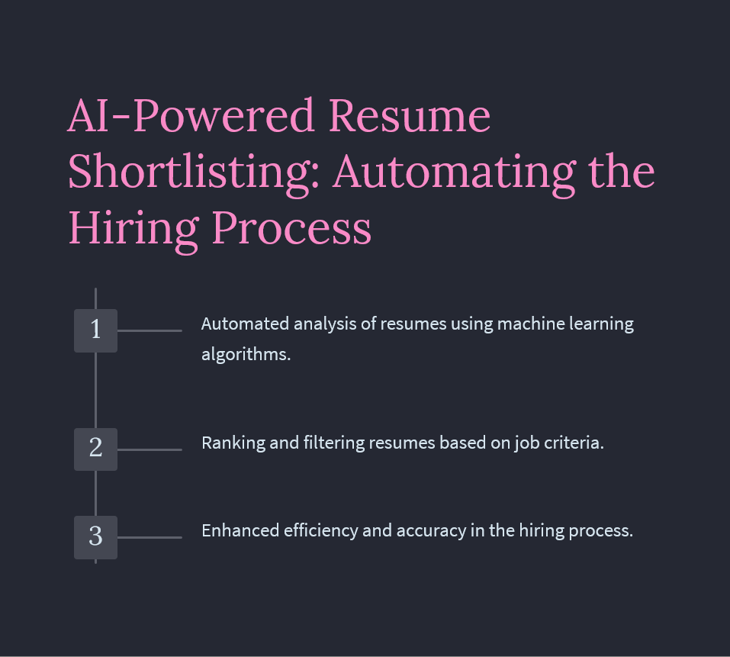
Modules (Contd.)

Slide 12
Workflow/Gantt Chart
Step-by-Step Flow:
User logs in/registers.
Users/companies manage profiles
User apply for the job
Companies post jobs.
Recommending the job according to skills
Users apply for jobs.
Upload resume on profile
Shortlisting the resume according to skill through AI
Notes:
Font Styles: Times New Roman + Font Size: 25

Slide 13
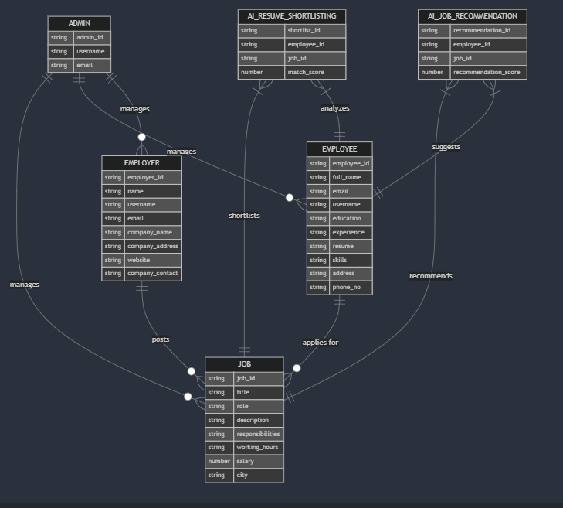
ER -DIAGRAM

Slide 14
Reports
Example Reports for Job Portal:
Job Applications:- Number of applications for each job.
User Activity: -Number of active users, profile updates.
Job Postings: -Total postings, active/inactive jobs.
Newsletter Reports: -Number of newsletters sent, open rates.
AI : - integrated to the job shortlisting for the candidate
Notes:
Font Styles: Times New Roman + Font Size: 25

Slide 15
References
Documentation:
https://react.dev/learn
https://nodejs.org/docs/latest/api/documentation.html
https://expressjs.com/en/5x/api.html
https://www.mongodb.com/docs/manual/
https://redux-toolkit.js.org/usage/usage-guide
Notes:
Font Styles: Times New Roman + Font Size: 25

Slide 16
THANK YOU
…………………………………………………………………………………………………………..

